Slide 1
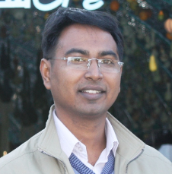
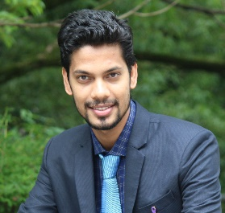
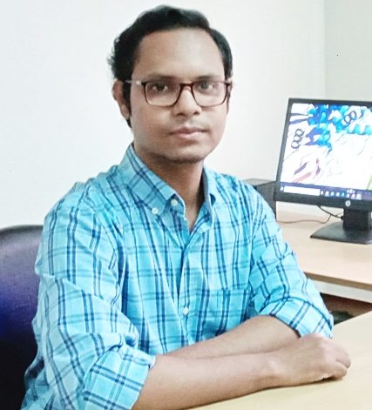
Iftekhar Alam, PhD
Senior Scientific Officer and Head
Plant Biotechnology Division
National Institute of Biotechnology
Email: ifte.alam@gmail.com
Mohammad Uzzal Hossain
Scientific Officer and In-charge
Bioinformatics Division
National Institute of Biotechnology
Email: uzzal@nib.gov.bd, uzzalbge10044@gmail.com
Ishtiaque Ahammad
Scientific Officer
Bioinformatics Division
National Institute of Biotechnology
Email: ishtiaquebioinfo@nib.gov.bd,
ishtiaque.ahammad@northsouth.edu

